Slide 1
TITLE Market Sales Analysis by Identifying Frequent Patterns UNDER THE GUIDANCE of Ms. Shahina Anwarul (Assistant Professor)

Slide 2
TEAM MEMBERS
S.No. | Roll No. | SAP ID | Team Members
1. | R134218206 | 500068730 | Karmanya Dadhich
2. | R134218123 | 500069734 | Pratham Pandey
3. | R134218125 | 500068183 | Pulkit Mittal
4. | R134218152 | 500067543 | Shashwat Chitransh

Slide 3
PROBLEM STATEMENT
>> Nowadays people buy daily goods from super market nearby. There are many supermarkets that provide goods to their customer. The problem many retailers face is the placement of the items. They are unaware of the purchasing habits of the customer so they don’t know which items should be placed together in their store. With the help of this application shop managers can determine the strong relationships between the items which ultimately helps them to put products that co-occur together close to one another and also to know which item to stock more.

Slide 4
OBJECTIVES
The primary objective of Market Sales Analysis is to improve the effectiveness of marketing and also predicting product sales in specific locations can improve shipping times and warehouse operations.
To identify the frequent items which will help to generate the association between the items

Slide 5
INTRODUCTION
FP-Tree represents all the relevant frequent information from a data set due to its compact structure
The great advantage of FP-Tree is that all the overlapping itemsets share the same prefix path. Because of this the information of the data set is highly compressed.
We will be using this technique of Data Mining to overcome the challenges of most of the business of marts and retailers
FP-Growth algorithm compresses the database into a frequent pattern tree (FP-tree) and still maintains the information of associations between item sets.

Slide 6
MOTIVATION
A data mining approach used in markets are targeting more customers by using Frequent Pattern Analysis using FP Growth Algorithm. By the help of this technique, the store manager will able to fulfill the requirements more as per need of the customers by showing them other sets of products that are closely related to a specific product known as combinations. This in turn will help in reducing the efforts of the customers by overcoming the problem of increased lookouts for other products.

Slide 7
LITERATURE REVIEW
1) Yuang, et al. recalls how Walmart in a study found that at certain time of a week (mostly Friday) products such as beer and diapers were bought together while applying FP growth algorithm.[1]
2) B.S Kumar, et al. proposed that one of the profound implementation of FP growth algorithm is in Web usage mining. This helps to better understand the common searching patterns that are used while visiting a particular website. For example, while reading about a certain smart phone on a website, some readers searched for headphones of the same manufacturer.[2]
3) In a research conducted by Sidhu, Shivam et al. FP growth algorithm was found particularly beneficial in order to obtain association rules between related data over old ideas such as Apriori algorithm which consist several drawbacks such as repeated scans of the whole database.[3]
4) Wang, Bowei, et al. explains how FP growth has also expanded its roots to medical science.It was usedto reveal some association rules from health information. For example, more than 30 % people suffering from hypertension are having high systolic pressure and liver problems.[4]

Slide 8
METHODOLOGY
FP-Growth algorithm compresses the database into a frequent pattern tree (FP-tree) and still maintains the information of associations between item sets.
Scanning the database for the first time, we can obtain a set of frequent items and their support count. The collection of frequent items is ordered by decreasing sequence of support count.
Then the algorithm creates the root node of the tree, with the tag “null.” Then it scans the database for the second time. Each item in a transaction is ordered by the sequence and later it creates a branch for each transaction.
For convenience of tree traversal, the algorithm creates an item header table. Each item through a node link points to itself in FP-tree.

Slide 9
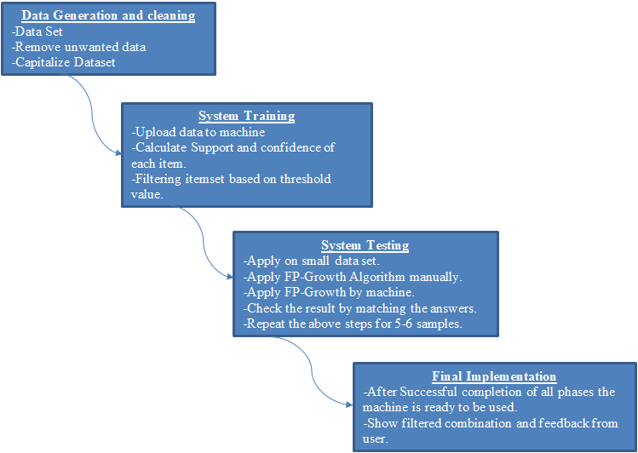
Flow chart of Methodology

Slide 10
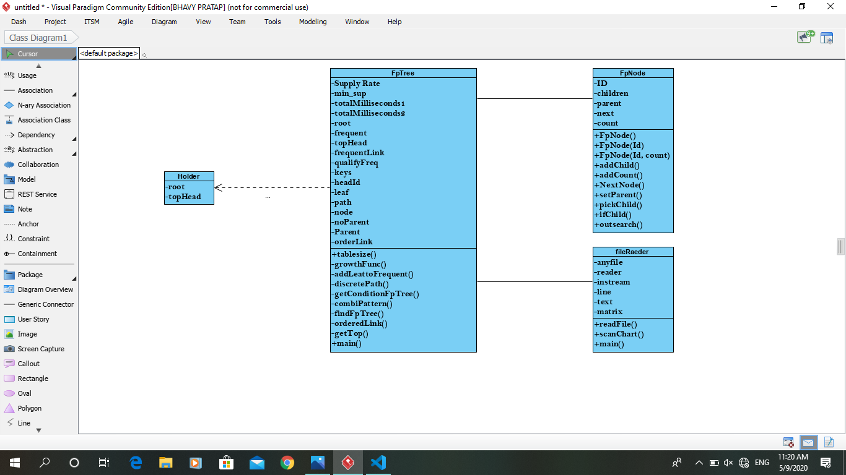
CLASS DIAGRAM

Slide 11
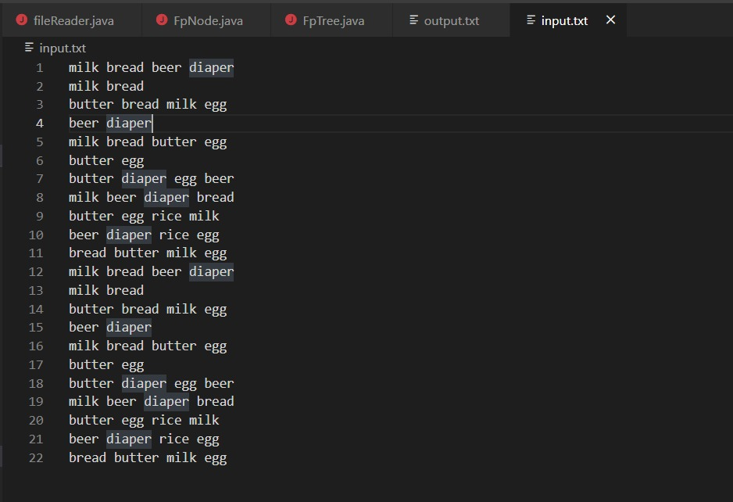
DATASET (INPUT)

Slide 12
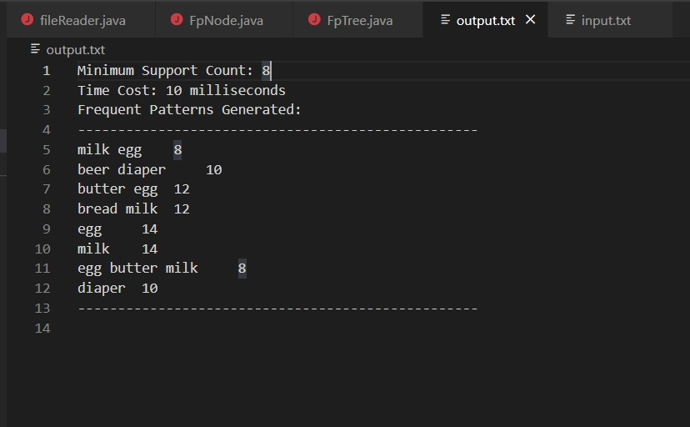
OUTPUT

Slide 13
CONCLUSION
The FP-Growth algorithm adequately creates profoundly instructive frequent item sets and association rules for the data of the grocery store. The frequent data things are produced from the given info data and dependent on the frequent item sets solid association rules were created, the FP growth algorithm is an improvement of the Apriori algorithm.
FP growth algorithm utilized for finding frequent itemset in an exchange database without candidate generation. In the event that the database converter is made, at that point the framework will work adequately for any configuration of data.
The FP-growth algorithm utilizes the 'Divide and Conquer' procedure and doesn't require candidate key generation tests. Besides, it doesn't experience rehashed outputs of the data. Thus, it very well may be securely inferred that the FP-growth algorithm has a tremendous future extension in the territory of advertising in the organized area. The application can be effectively utilized by many as a better marketing strategy in future.

Slide 14
REFERENCES
[1] Yuan, M., Pavlidis, Y., Jain, M. and Caster, K., 2016, November. Walmart online grocery personalization: Behavioral insights and basket recommendations. In International Conference on Conceptual Modeling (pp. 49-64). Springer, Cham.
[2] Kumar, B.S. and Rukmani, K.V., 2010. Implementation of web usage mining using APRIORI and FP growth algorithms. Int. J. of Advanced networking and Applications, 1(06), pp.400-404.
[3] Sidhu, Shivam, et al. "FP Growth algorithm implementation." International Journal of Computer Applications 93.8 (2014).
[4] Wang, Bowei, et al. "Comprehensive association rules mining of health examination data with an extended FP-growth method." Mobile Networks and Applications 22.2 (2017): 267-274.

